Slide 1


Python
Project
Sakthivel P

Slide 2
Car Crash in Brazil
Project Overview:
This project analyzes traffic accident data across Brazil from 2017 to 2023 to uncover patterns and insights related to when, where, and why accidents occur.
Objective :
The goal is to understand how factors like weather, road type, time of day, and day of week influence the severity and frequency of road accidents and helping support decisions in traffic safety, emergency response, and policy planning.

Slide 3
Data Understanding:
Dataset Overview:
Source of Data:
Brazilian Federal Highway Police accident reports from 2017 to 2023.
Dataset Summary:
Total Records: 463,152 accident reports
Time Frame: January 2017 to December 2023
Geographic Coverage: All Brazilian states

Slide 4
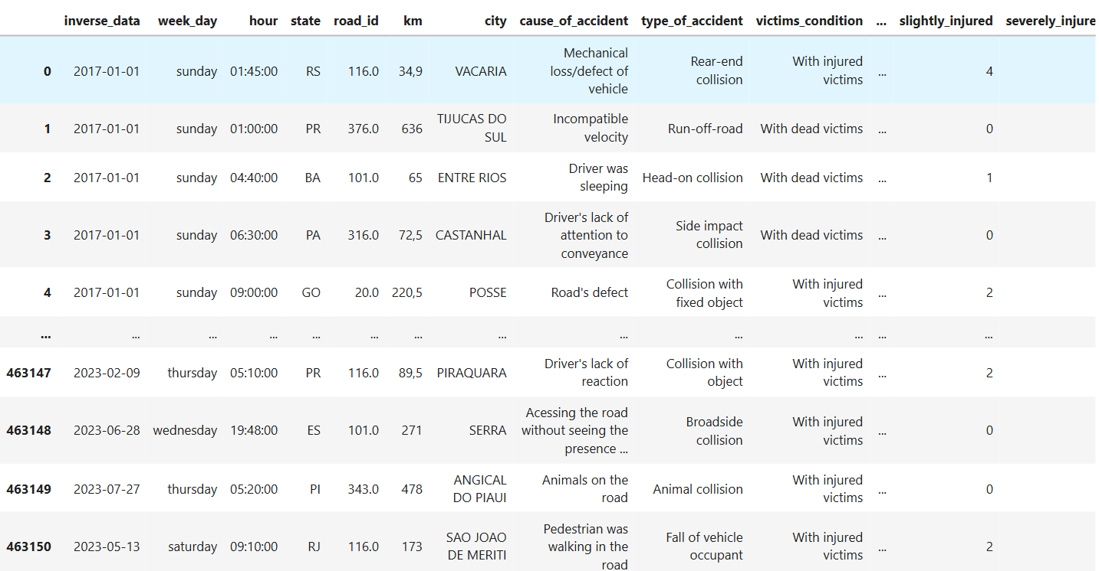
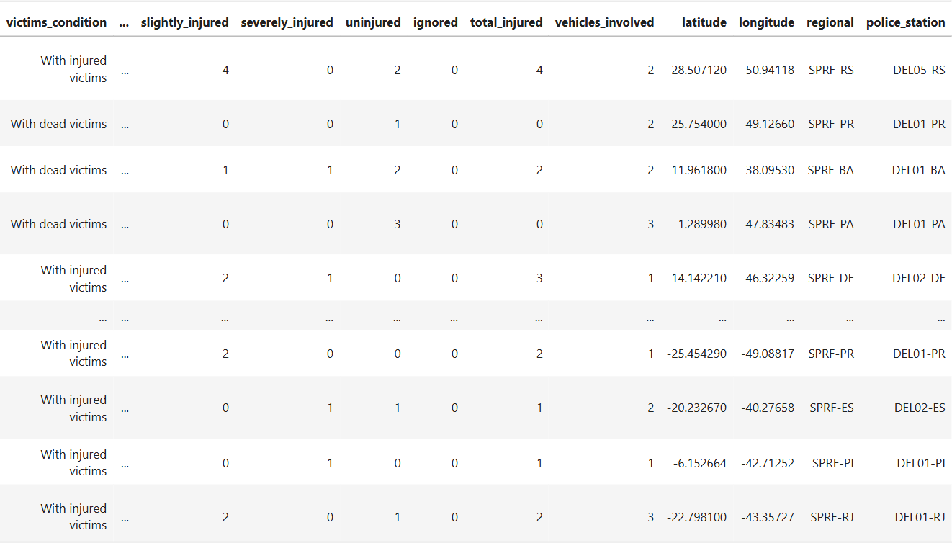

Slide 5
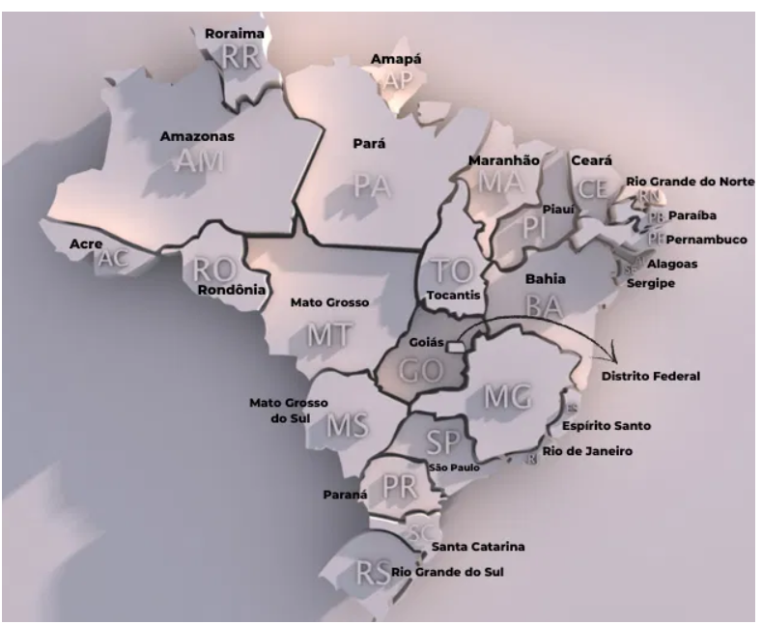
Key Attributes:
Variable | Description
date | Date of the accident
weekday | Day of the week
state | Brazilian state where the accident occurred
type_of_accident | Type of crash (e.g., rear-end, head-on)
weather_condition | Weather at the time of the accident
road_type | Road structure (simple, double, etc.)
road_delineation | Road layout (curve, straight, detour)
people | Number of people involved
injured / deaths | Severity outcome
vehicles_involved | Number of vehicles in the accident

Slide 6
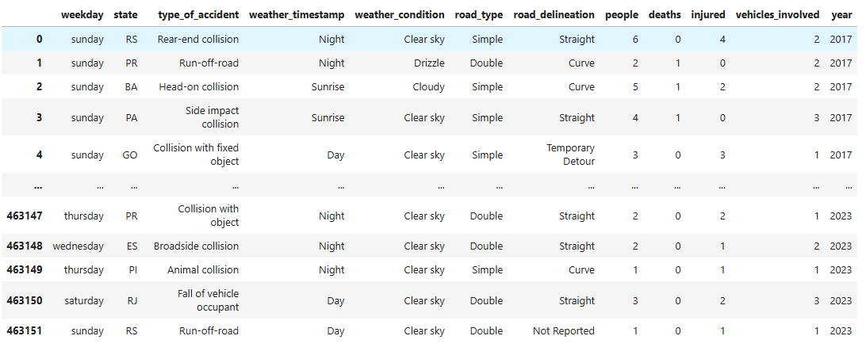
Data cleaning:
Removing columns
Renaming the columns
object to Date format
Filtering year

Slide 7
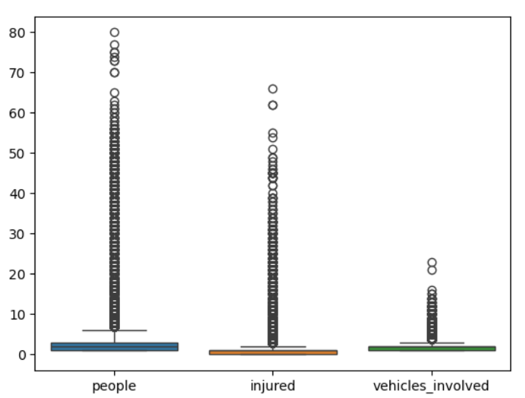
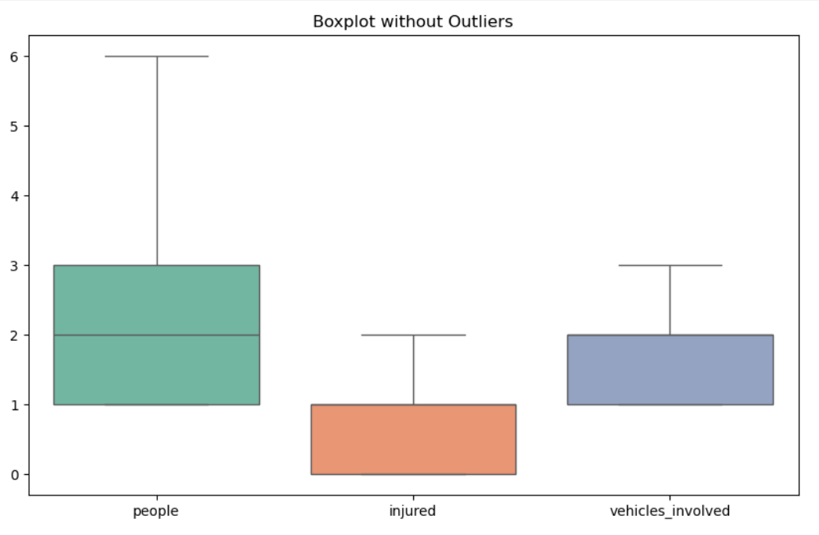
Outlier Handling:

Slide 8
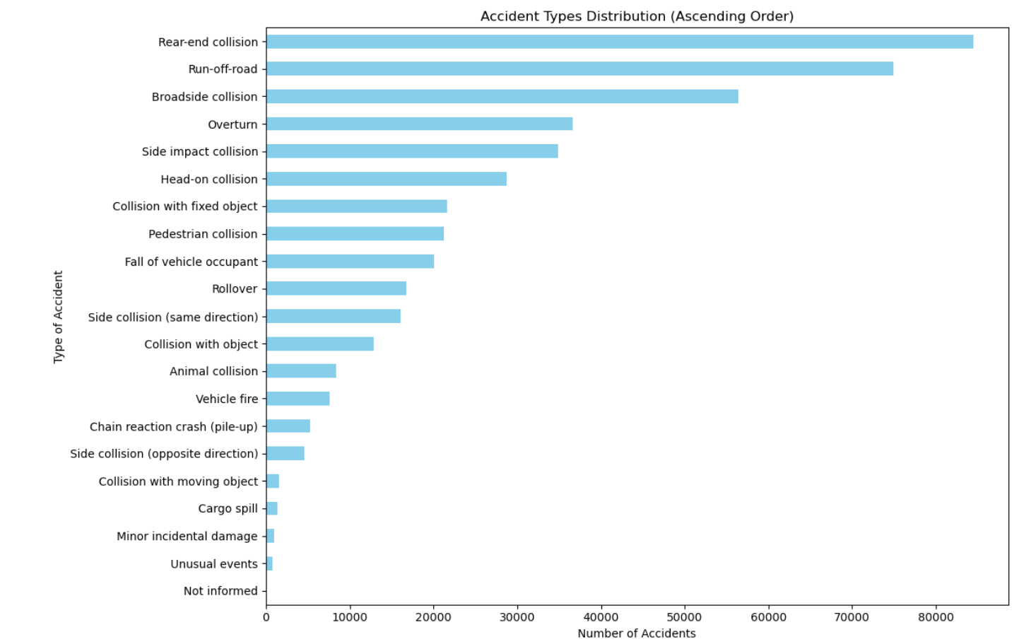
Data Visualization:
Explanation : Understanding which types of accidents occur most frequently helps traffic authorities and planners focus safety measures where they are most needed.
Insight : The most common type of accident was rear - end collisions, significantly higher than other types.
Interpretation : Rear-end collisions often result from not following distance, distraction, or sudden braking.

Slide 9
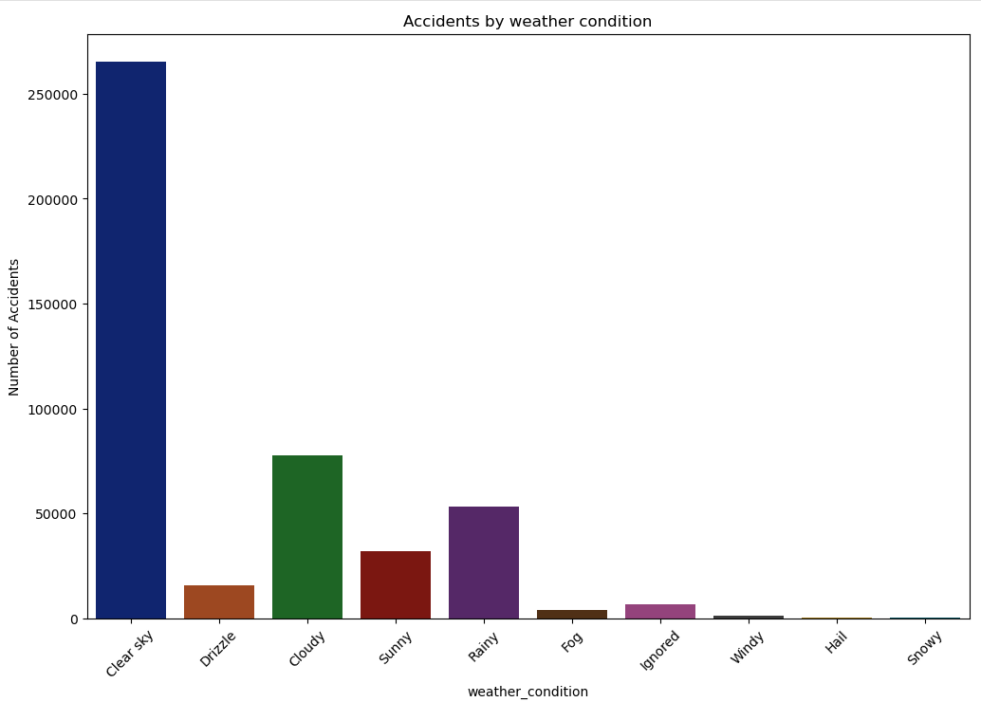
Explanation : Weather can significantly affect visibility, friction, and driver behavior.
Insight : Most accidents occurred under clear sky conditions, followed by cloudy and then rainy weather.
Interpretation : This points toward human behavior is cause of accident in clear sky. Rainy making roads slippery, which can lead to reduced tire grip.

Slide 10
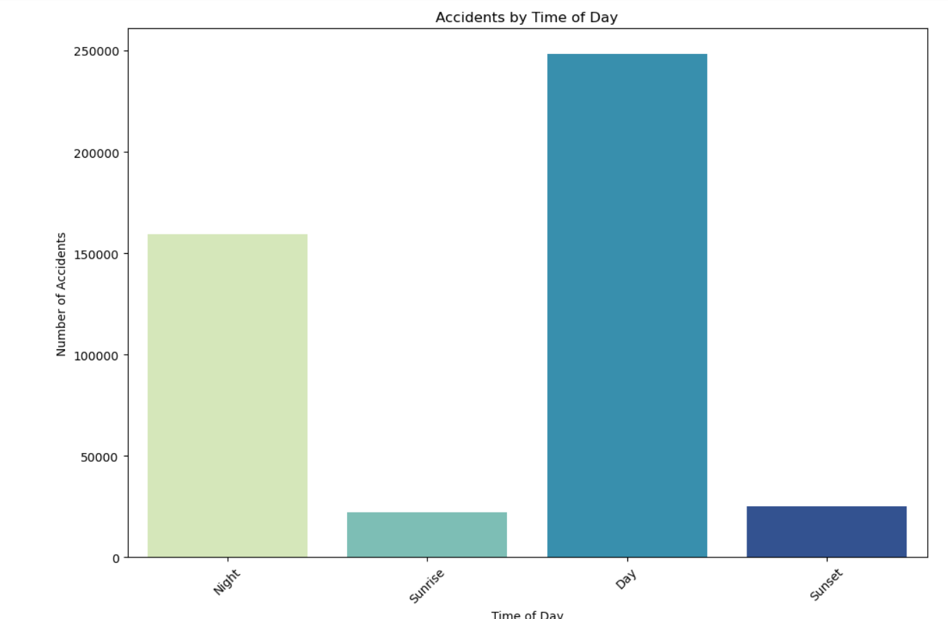
Explanation : Time of day is critical in identifying risk periods, such as night driving or rush hours.
Insight : The majority of accidents occurred during the day.
Interpretation : This is likely due to higher traffic volumes during the day.
Night time accidents, while less frequent, alcohol use, or poor visibility.

Slide 11
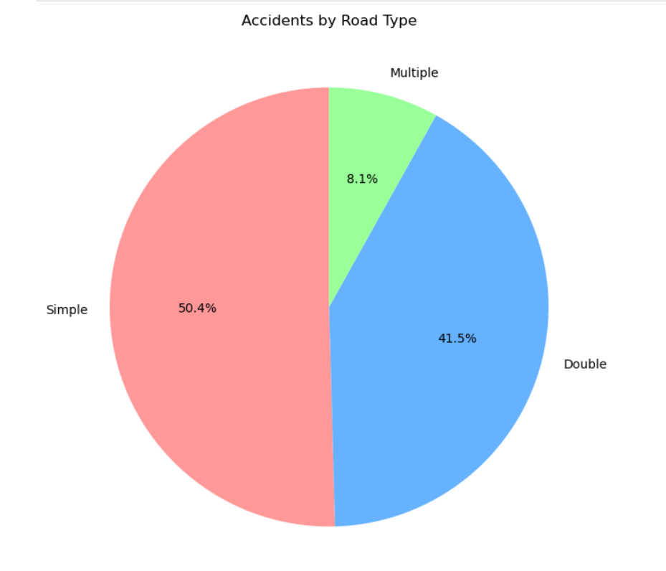
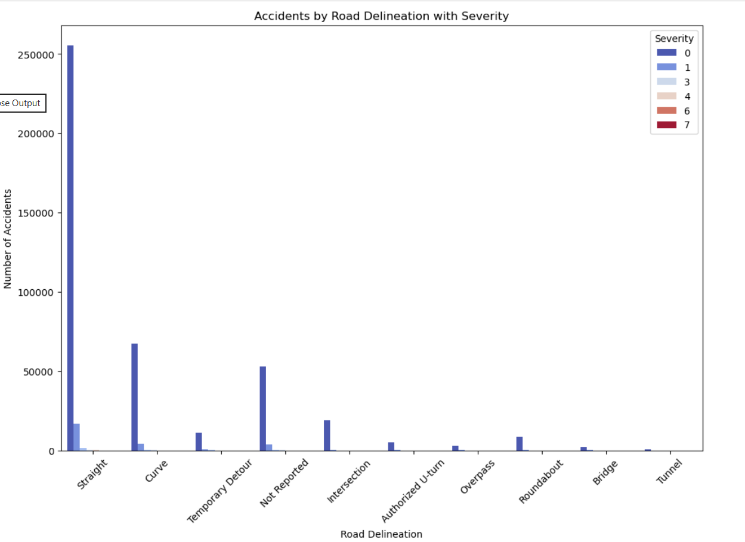

Slide 12
Road Type and Delineation:
Explanation: We explored whether specific road types or geometries (straight, curved, etc.) are more associated with accidents.
Insight: Most accidents happened on simple road types and straight road delineations.
Interpretation: Simple, straight roads can lead to overconfidence, speeding, and loss of attention.
Drivers may perceive these roads as safer and reduce their alertness, leading to crashes.

Slide 13
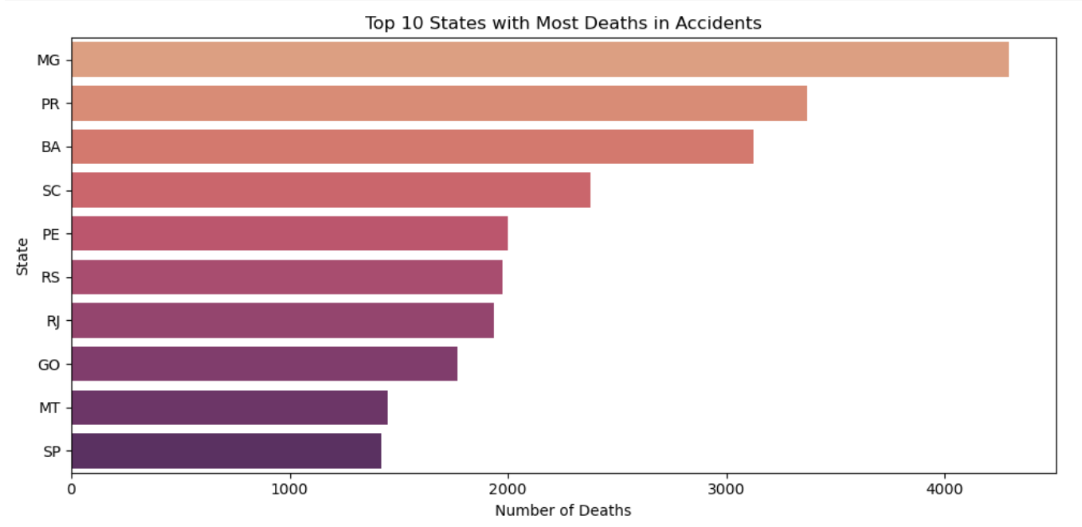

Slide 14
Top 10 States with Most Deaths in Accidents
Explanation: We analyzed road accident fatalities across all Brazilian states to identify where the most deaths occurred.
Insight: Minas Gerais (MG), Paraná (PR), and Bahia (BA) are the top 3 states with the highest number of deaths.
Interpretation: Larger states like MG and BA often have vast road networks with long-distance travel routes, increasing exposure to accidents.
Additionally, high-speed rural roads and freight traffic contribute to risk.

Slide 15
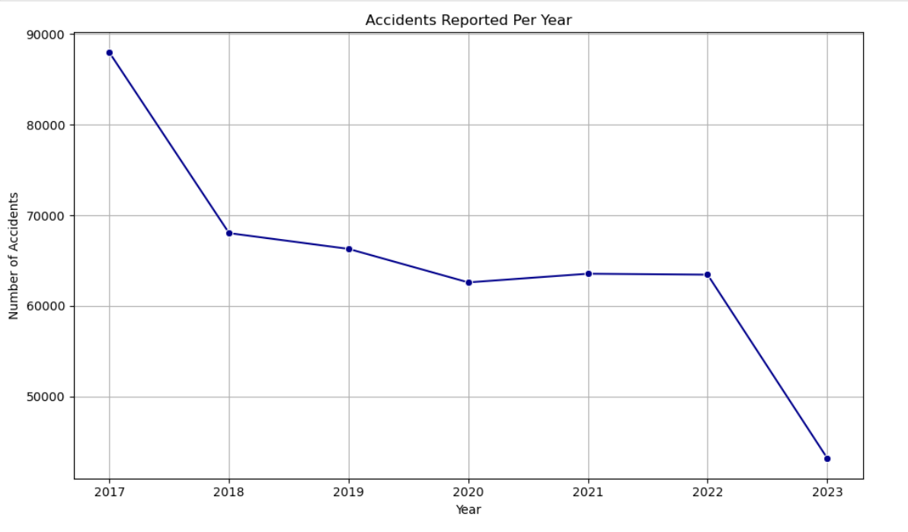

Slide 16
Explanation: Understanding how the number of accidents has changed over time helps us evaluate the effectiveness of public safety campaigns, road safety laws, and infrastructure improvements.
Insight: The number of traffic accidents was highest in 2017 and consistently decreased year by year, reaching a significantly lower level in 2023.
Interpretation: Improved traffic enforcement
Changes in traffic patterns
COVID-19 pandemic (2020–2021), which reduced vehicle flow.

Slide 17
Hypothesis Test:
Hypothesis Test 1: Are accidents more severe at night than during the day?
Test whether injuries during night time accidents are significantly higher than daytime accidents.
Test:
Independent Samples t-test
Hypothesis:
Null (H₀): Mean injuries during day = night
Alternate (H₁): Mean injuries during night ≠ day
T-Statistic: -28.87939246199988
P-Value: 3.66804542555192e-183
If p < 0.05, reject H₀ → Nighttime injuries are statistically significantly higher.
Otherwise → No significant difference.
P-Value is extremely small:
So, reject the null hypothesis.
Conclusion: There is a statistically significant difference between day and night injury counts.

Slide 18
Hypothesis Test 2: Does weather condition affect the number of people involved in accidents?
Check if the mean number of people involved in accidents differs by weather condition.
Test:
One-way ANOVA
Hypothesis:
H₀: Mean people involved is equal across weather conditions
H₁: At least one weather condition has a different mean
Null Hypothesis (H₀): The means are equal across all weather conditions.
Alternative Hypothesis (H₁): At least one group’s mean is different.
P-value is extremely small:
reject the null hypothesis.
Conclusion: There is a statistically significant difference in the number of people involved in accidents across different weather conditions.
Weather condition has an effect on how many people are involved.
F-Statistic: 32.01382600856288
P-Value: 1.2535270856082492e-14

Slide 19
Conclusion:
Focus on rear-end collision prevention (safe distance, distraction-free driving, speedbreak installization).
Strengthen real-time alerts and warnings during fog, drizzle, or rain, which tend to lead to larger-scale crashes.
If you do have to drive in bad weather or at night, ensure your lights (including fog lights) work properly.
Focus on the road: Avoid distractions like mobile phones and focus on driving.
Speed Control: Operate at appropriate speeds and avoid sudden stops, especially when carrying loads.

Slide 20
THANK YOU!

